Slide 1

Power BI Dashboard Presentation
Title: Sales & Performance Analysis using Power BI

Slide 2
Introduction Objective of the Dashboard Analyzing sales trends Identifying top-selling products Understanding customer purchasing behavior Evaluating product line performance Key Metrics Covered Total Sales, Profit Margin, Orders, Top Products, and Trends
- Power bi

Slide 3
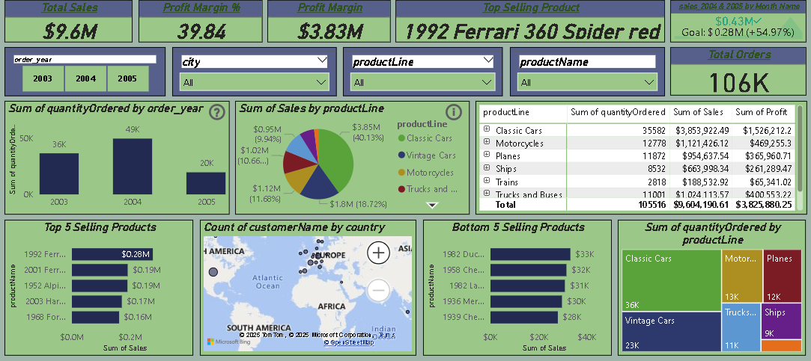
- Power bi

Slide 4
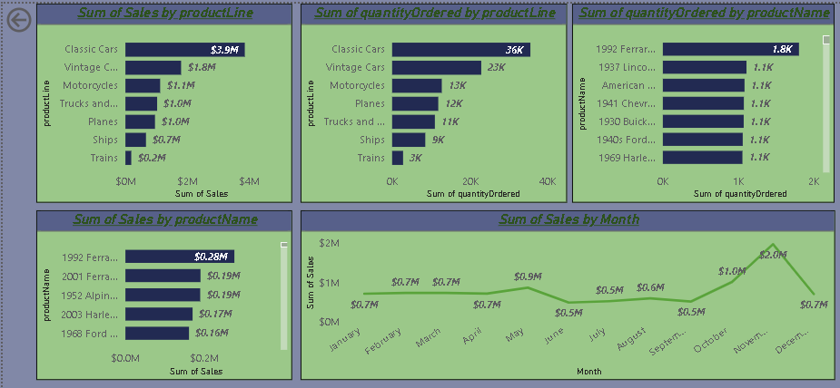
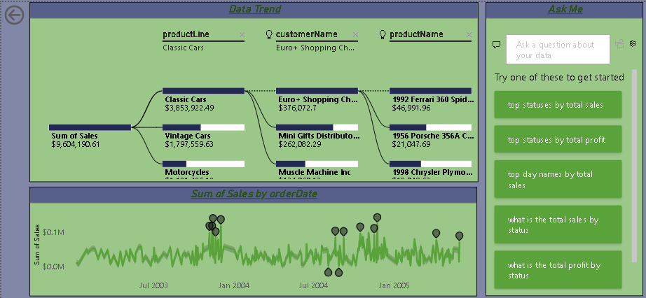
- Power bi

Slide 5
Overview of Key Metrics Total Sales: $9.6M Total Orders: 106K Profit Margin: 39.84% Top-Selling Product: 1992 Ferrari 360 Spider Red Goal Achievement for 2004-2005: 54.97% above the target
- Power bi

Slide 6
Sales Analysis by Product Line Which product line generates the highest sales? Classic Cars: $3.85M (Top Category) Vintage Cars: $1.8M Motorcycles: $1.12M Which product line has the lowest sales? Trains: $0.2M
- Power bi

Slide 7
Sales Performance by Product Top 3 Best-Selling Products: 1992 Ferrari 360 Spider Red – $0.28M 2001 Ferrari Enzo – $0.19M 1952 Alpine Renault – $0.17M Bottom 2 Selling Products: 1982 Ducati – $33K 1968 Chevrolet – $32K
- Power bi

Slide 8
Sales Trend Over Time What are the peak months for sales? November: $2M (Highest) April: $0.9M How did sales fluctuate over the years? 2003: 36K orders 2004: 49K orders 2005: 20K orders
- Power bi

Slide 9
Customer & Country-Wise Analysis Which customer generated the highest sales? Euro+ Shopping Channel – $376,072 Sales distribution by country Highest sales in America and Europe
- Power bi

Slide 10
Profit & Goal Achievement What is the total profit margin? $3.83M (39.84%) Was the sales goal achieved in 2004 & 2005? Goal: $0.28M | Achieved: $0.43M (54.97% above target)
- Power bi

Slide 11
Key Business Takeaways Classic Cars are the highest revenue-generating category. November is the best-performing month for sales. The 1992 Ferrari 360 Spider Red is the top-selling product. The company exceeded sales goals by 54.97% in 2004 & 2005. Highest sales concentration is in America & Europe.
- Power bi

Slide 12
Conclusion & Next Steps What insights can drive future strategies? Focus on high-performing products like Classic Cars Increase marketing efforts in peak sales months Expand sales strategies in top-performing countries Next Steps Deeper customer segmentation analysis Identifying opportunities in underperforming product lines
- Power bi

Slide 13
"Thank you for your time and attention!"
Gaurav Singh Panwar
9711407364
panwargaurav813@gmail.com

